Slide 1
Static & Default Routing
김준희

Slide 2
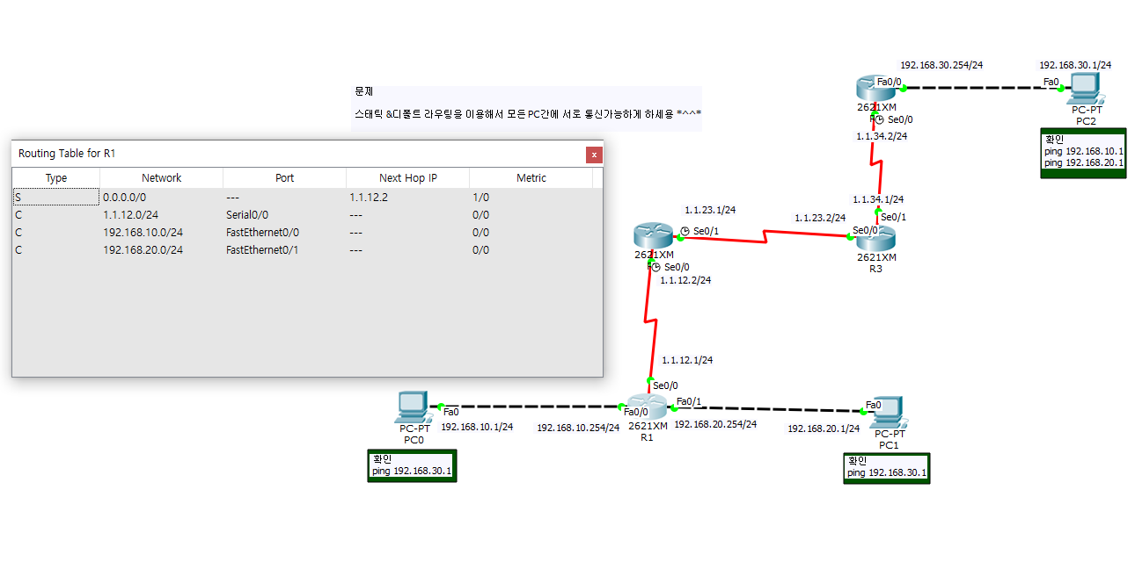
R1 Routing Table

Slide 3
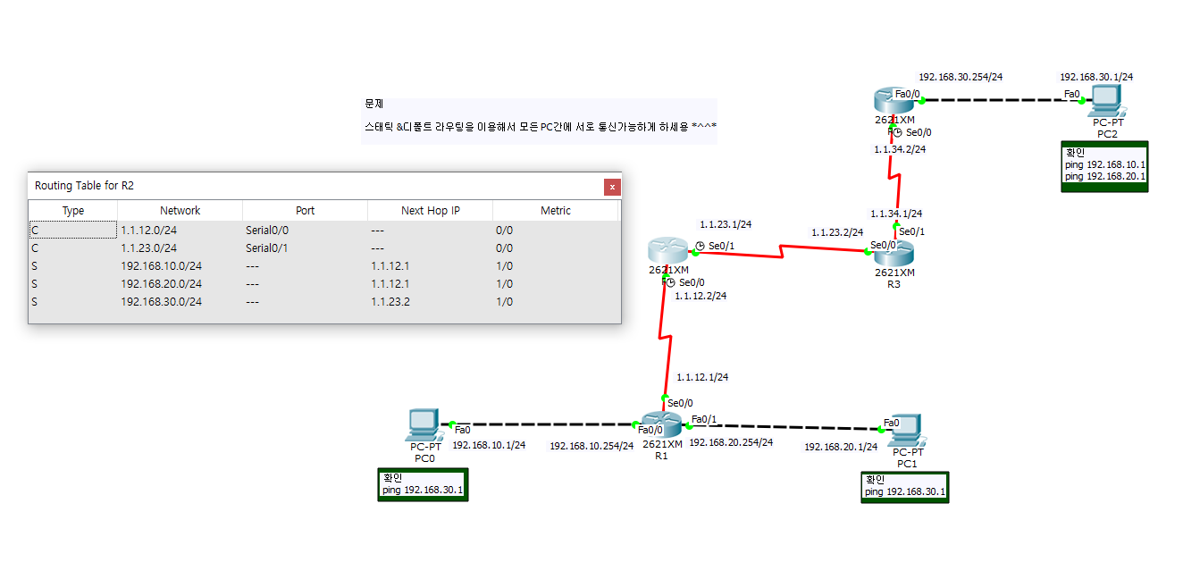
R2 Routing Table

Slide 4
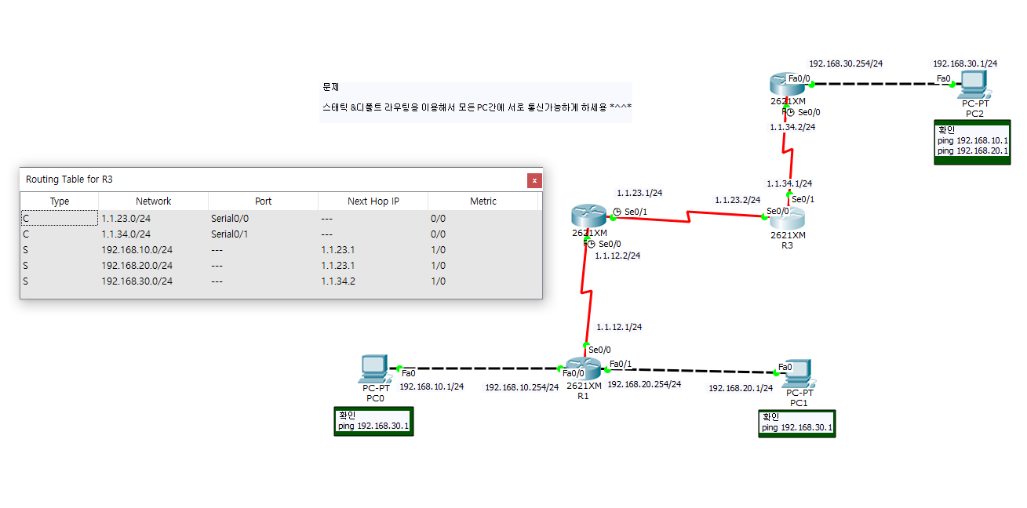
R3 Routing Table

Slide 5
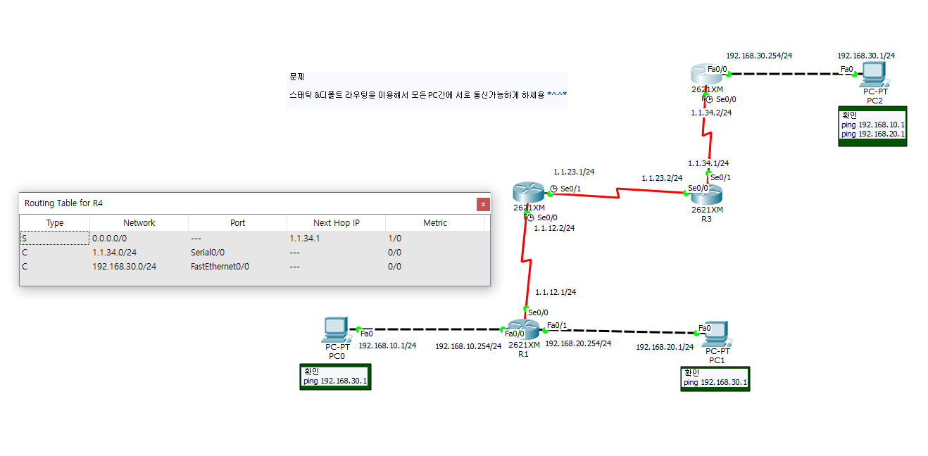
R4 Routing Table

Slide 6
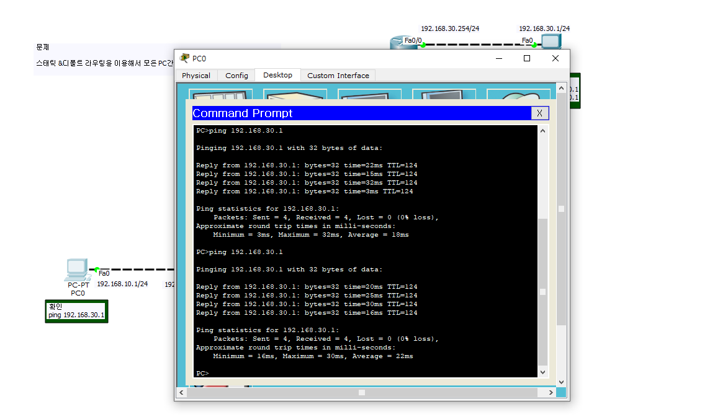
PC0 ping 192.168.30.1

Slide 7
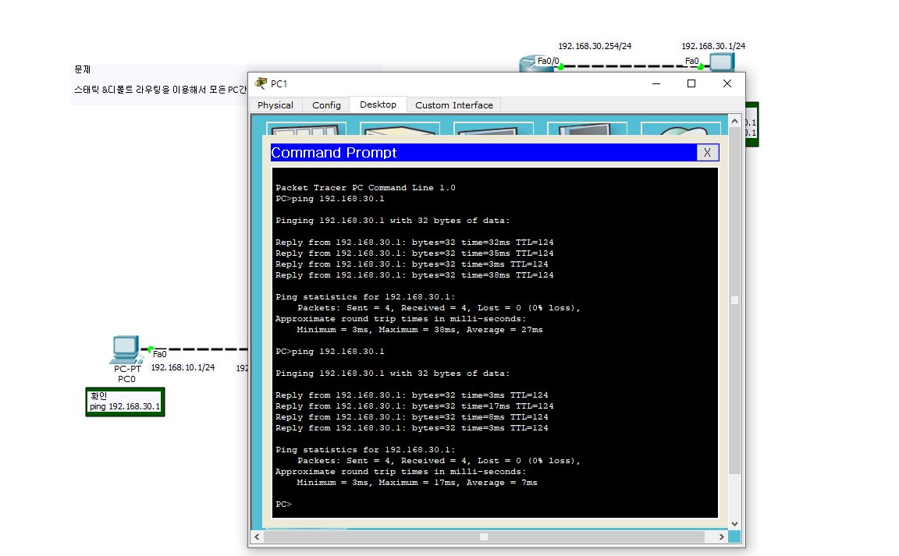
PC1 ping 192.168.30.1

Slide 8
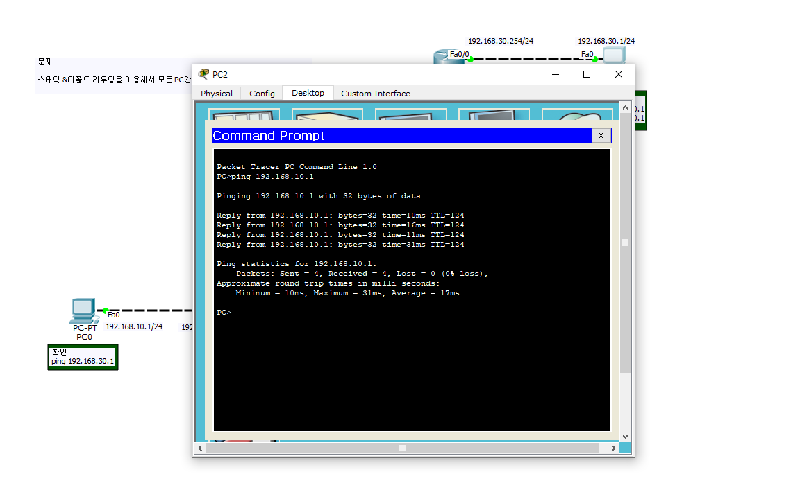
PC2 ping 192.168.10.1

Slide 9
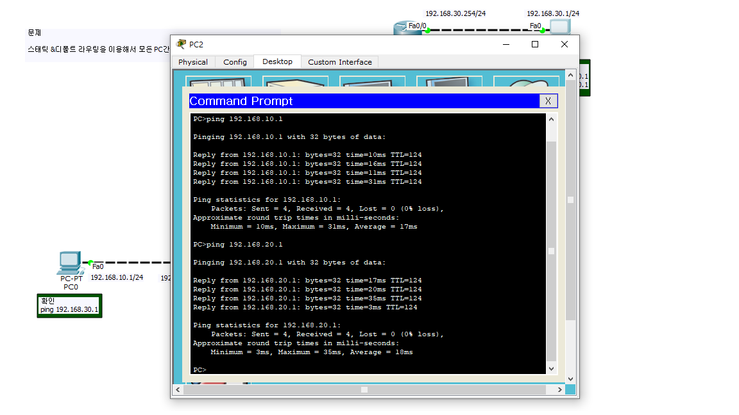
PC2 ping 192.168.20.1

